Slide 1
ELEC 4727/5727
Computer Vision & Image Processing
Lecture 1
Course Introduction

Slide 2
Welcome!
Course Number: ELEC 4727/5727
Introduction (instructor, students, course)
What is computer vision/digital image processing?

Slide 3
Introduction - instructor
Dr. Chao Liu
Ph.D., Purdue University, West Lafayette, IN, USA
Email: chao.liu@ucdenver.edu
Office: NC 2421

Slide 4
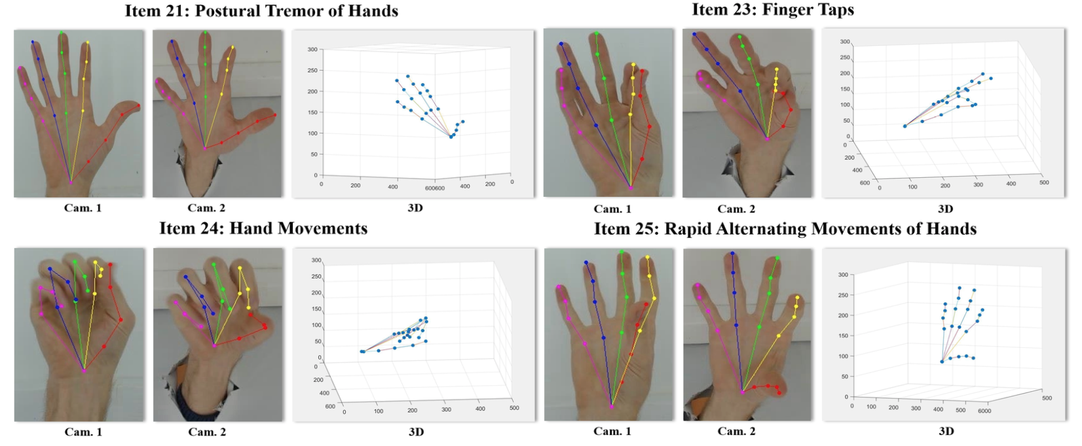
Introduction - instructor
My research work
Automatic detection and quantification of hand movements
in Parkinson's disease

Slide 5
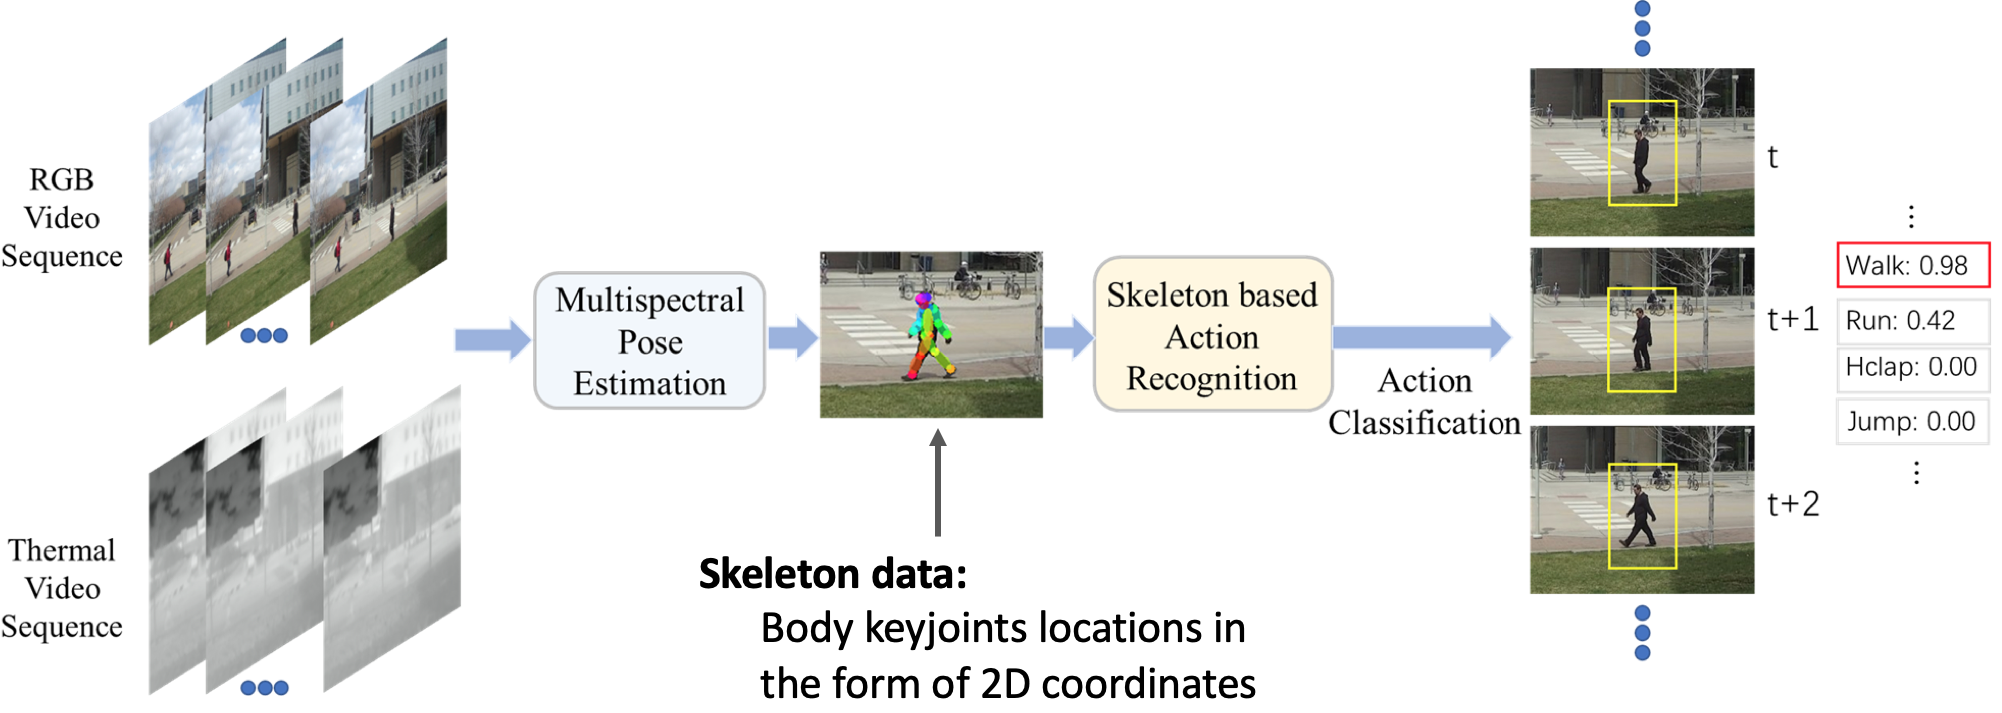
Introduction - instructor
My research work
Multispectral Skeleton-based Human Action Recognition model

Slide 6
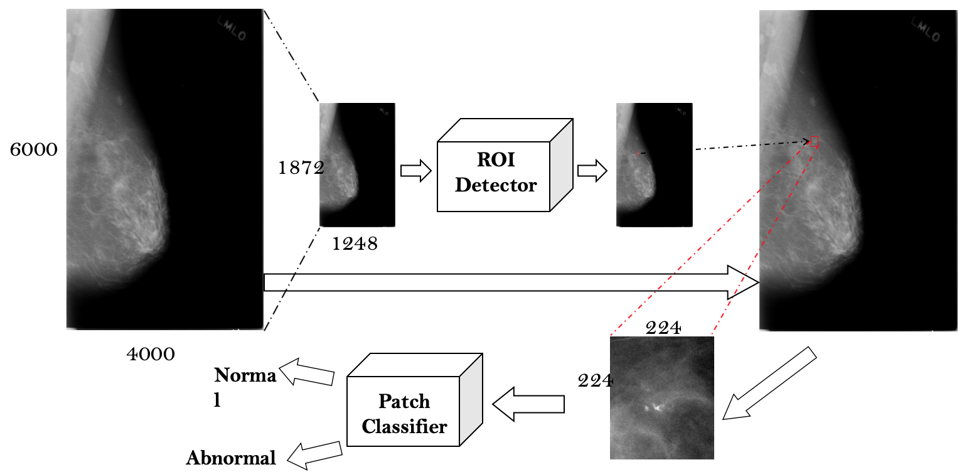
Introduction - instructor
My research work
Automatic Classification of Calcifications and Masses In Breast Mammograms

Slide 7
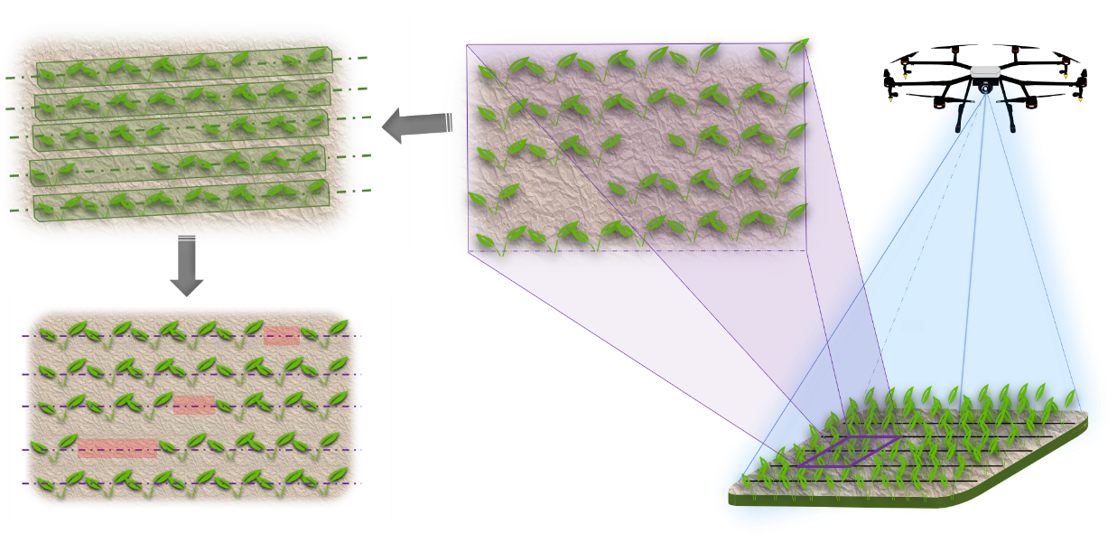
Introduction - instructor
My research work
Automatic determination of early-season stand count using remote sensing
and deep neural network

Slide 8

Introduction - instructor
My research work
DARPA Subterranean Challenge

Slide 9
Introduction – students

Slide 10
Introduction – Course
2D signal processing, Basic image processing methods
Color space, Pointwise operation, Correction, Calibration
Spatial filtering, Image enhancement (histogram, contrast, edge)
Frequency domain filtering, Image restoration
Image analysis, Quality assessment
Morphological image processing
Image segmentation
Human visual system, Image perception
Image halftone technique, Image compression
Depth acquisition
Face/finger print/iris recognition
Object recognition/detection (machine learning based)
Object recognition/detection (deep learning based)
Image segmentation (deep learning based)

Slide 11
Introduction – Course
Digital Image Processing 3rd Ed
Digital Image Processing Using MATLAB 2nd Ed
We only use python!!!

Slide 12
Introduction – Course
Assignments (>= 5) 40%
(including in-class work and homework )
Projects (3) 40%
Final Project (1) 20%

Slide 13
What is an image?

Slide 14
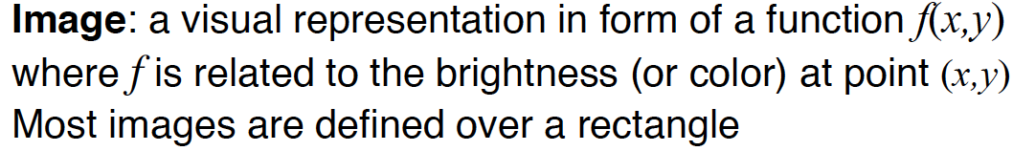
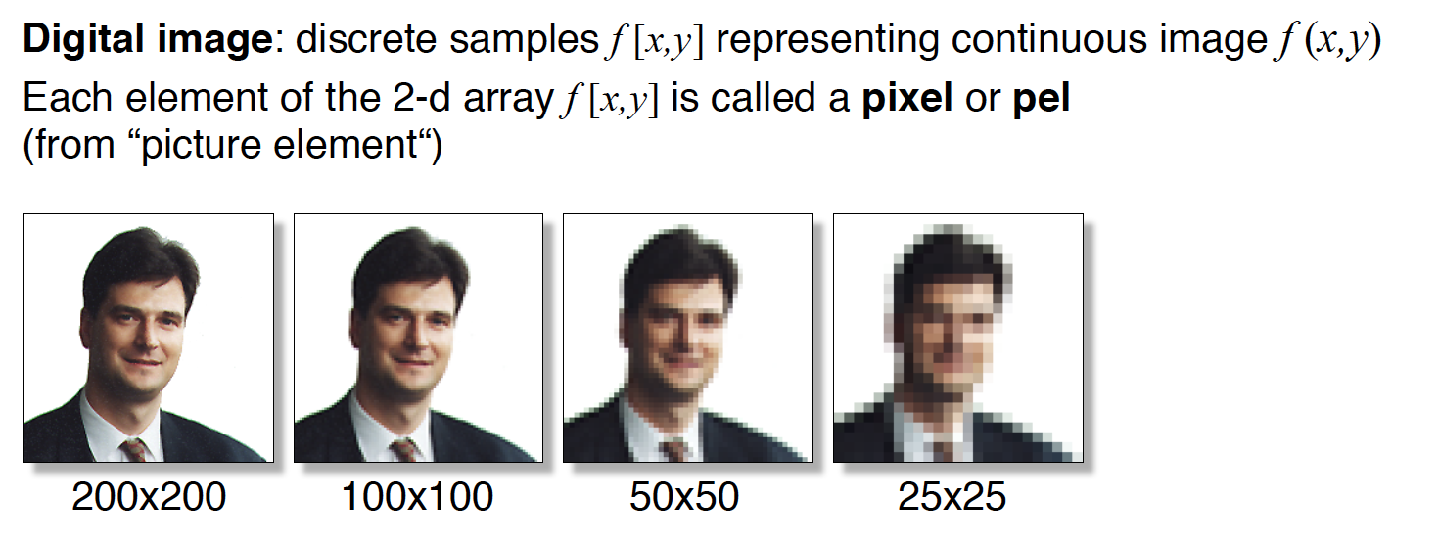
Digital Image

Slide 15
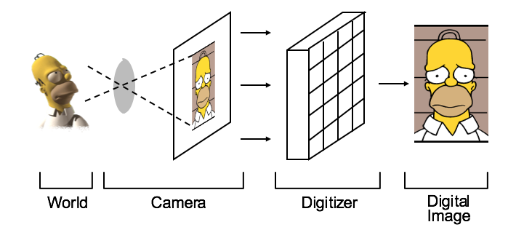
Imaging System
Image acquisition

Slide 16
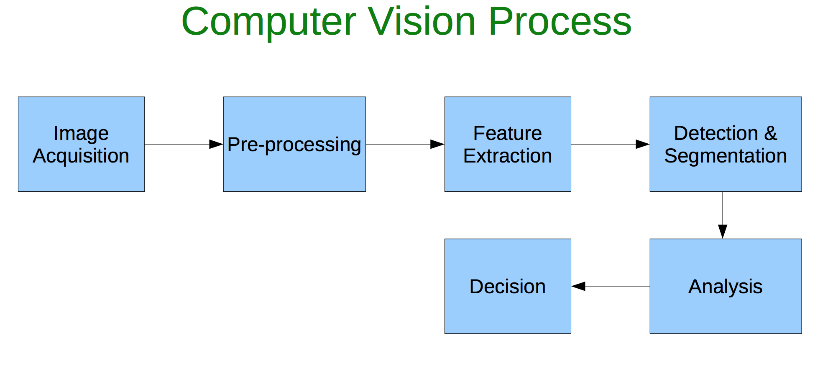
Imaging System

Slide 17
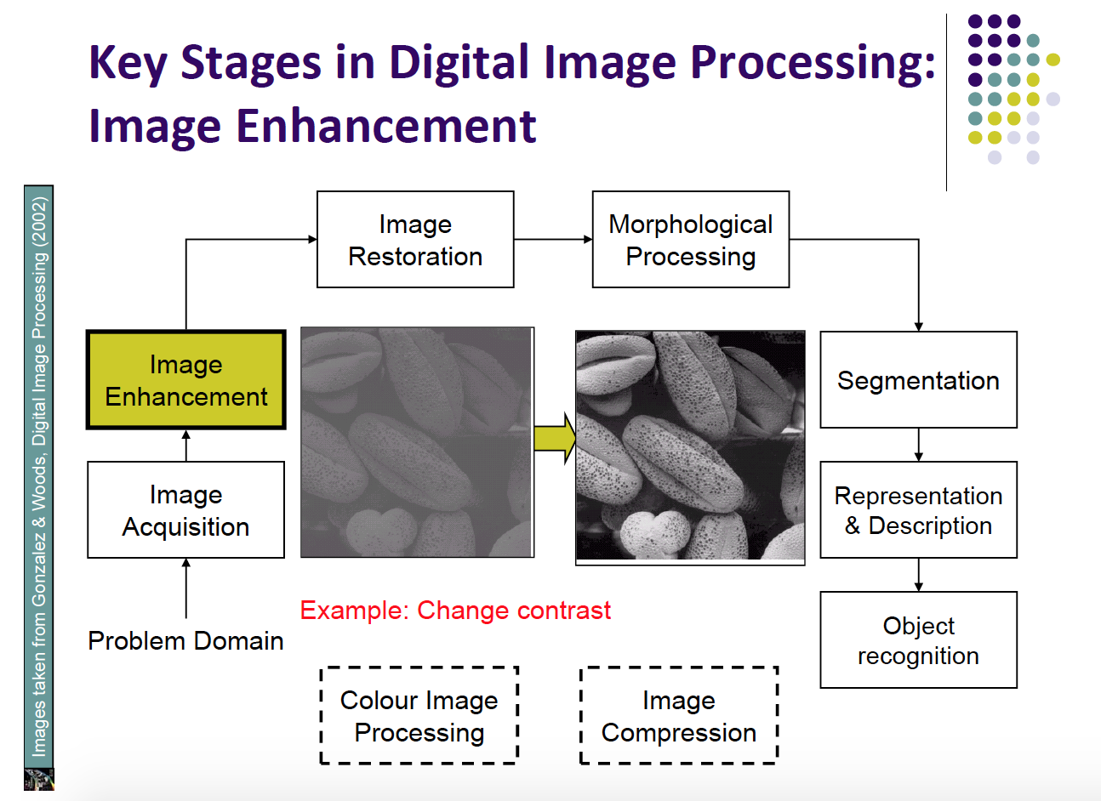
Digital Image Processing

Slide 18
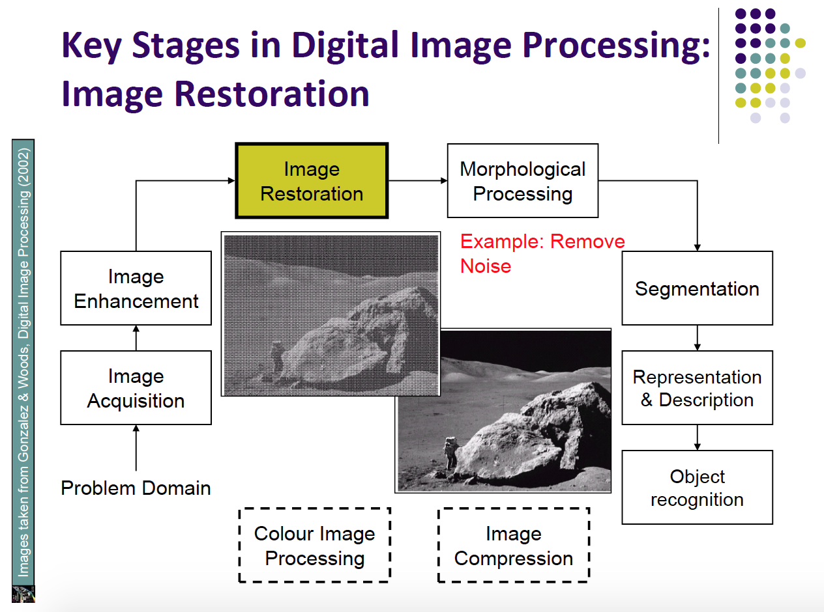
Digital Image Processing

Slide 19
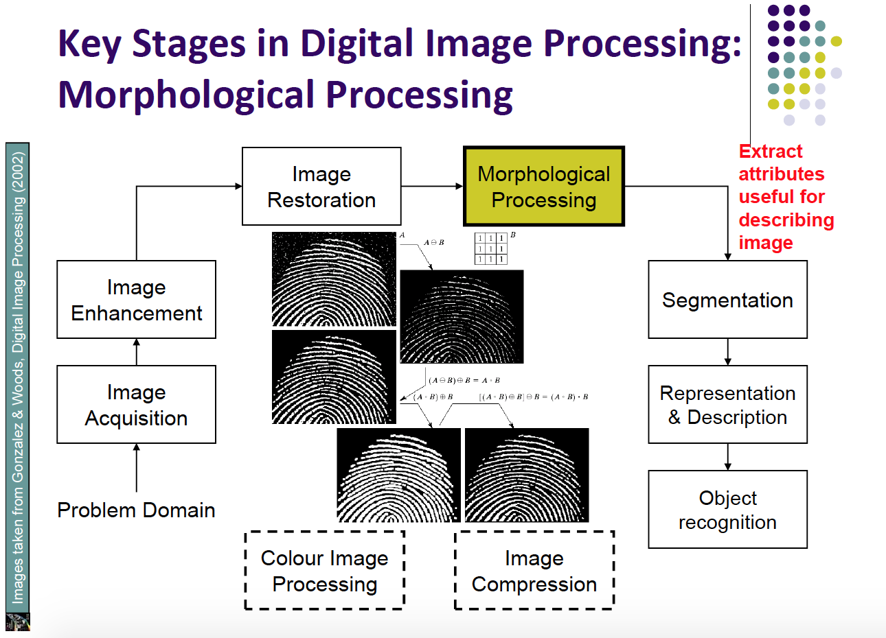
Digital Image Processing

Slide 20
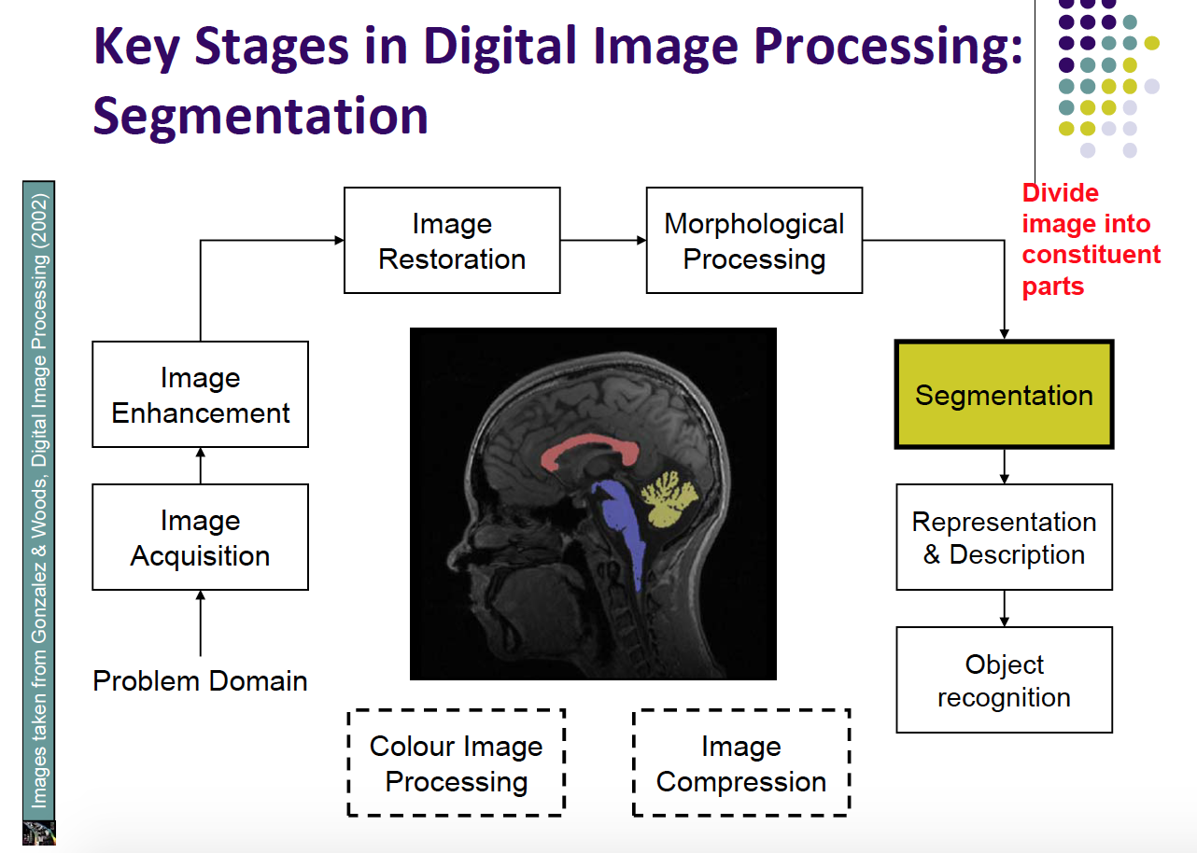
Digital Image Processing

Slide 21
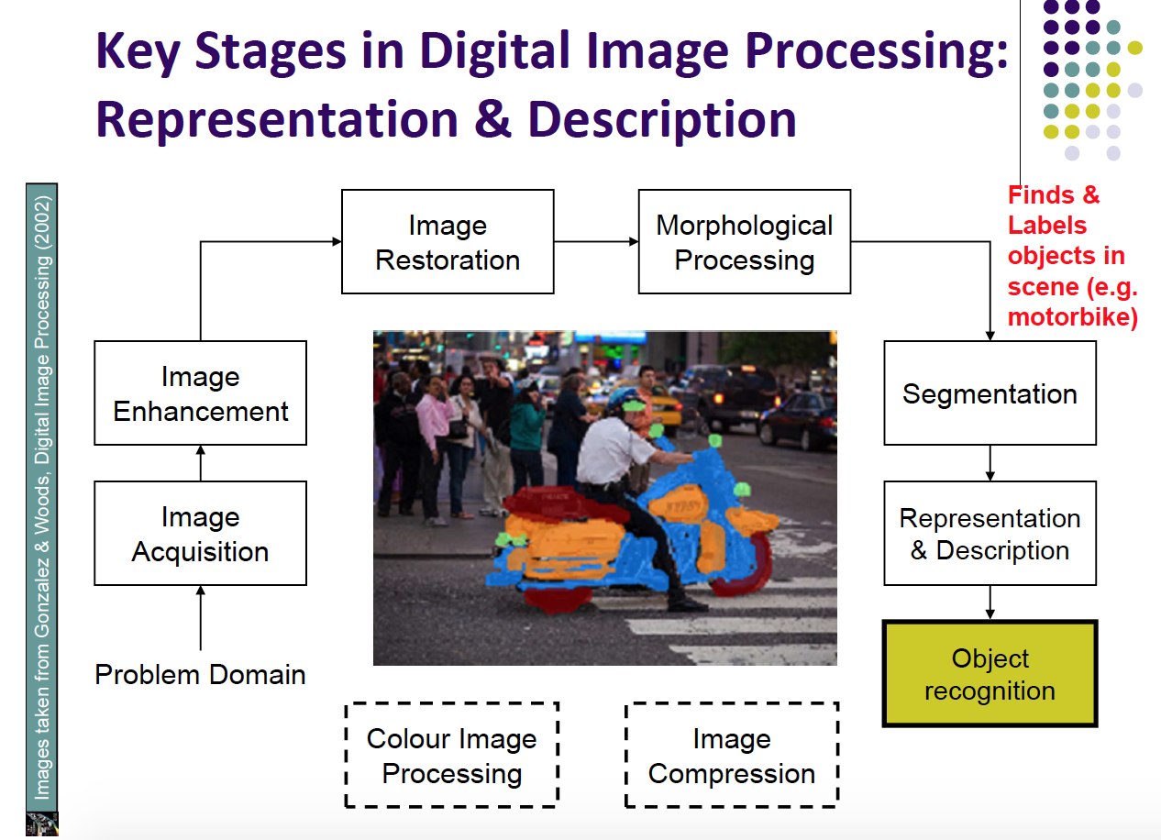
Digital Image Processing

Slide 22
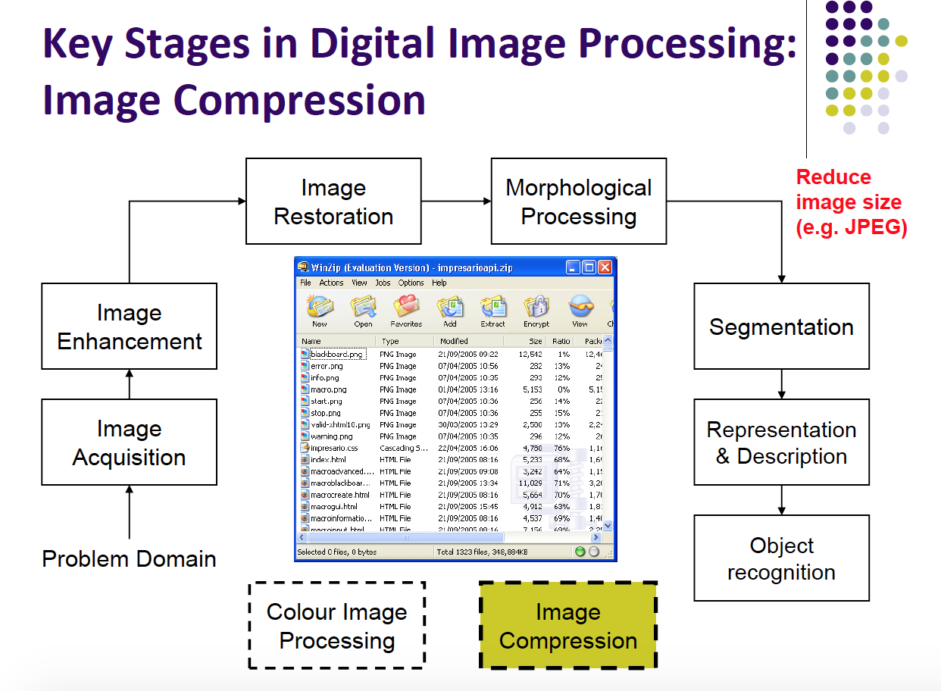
Digital Image Processing

Slide 23
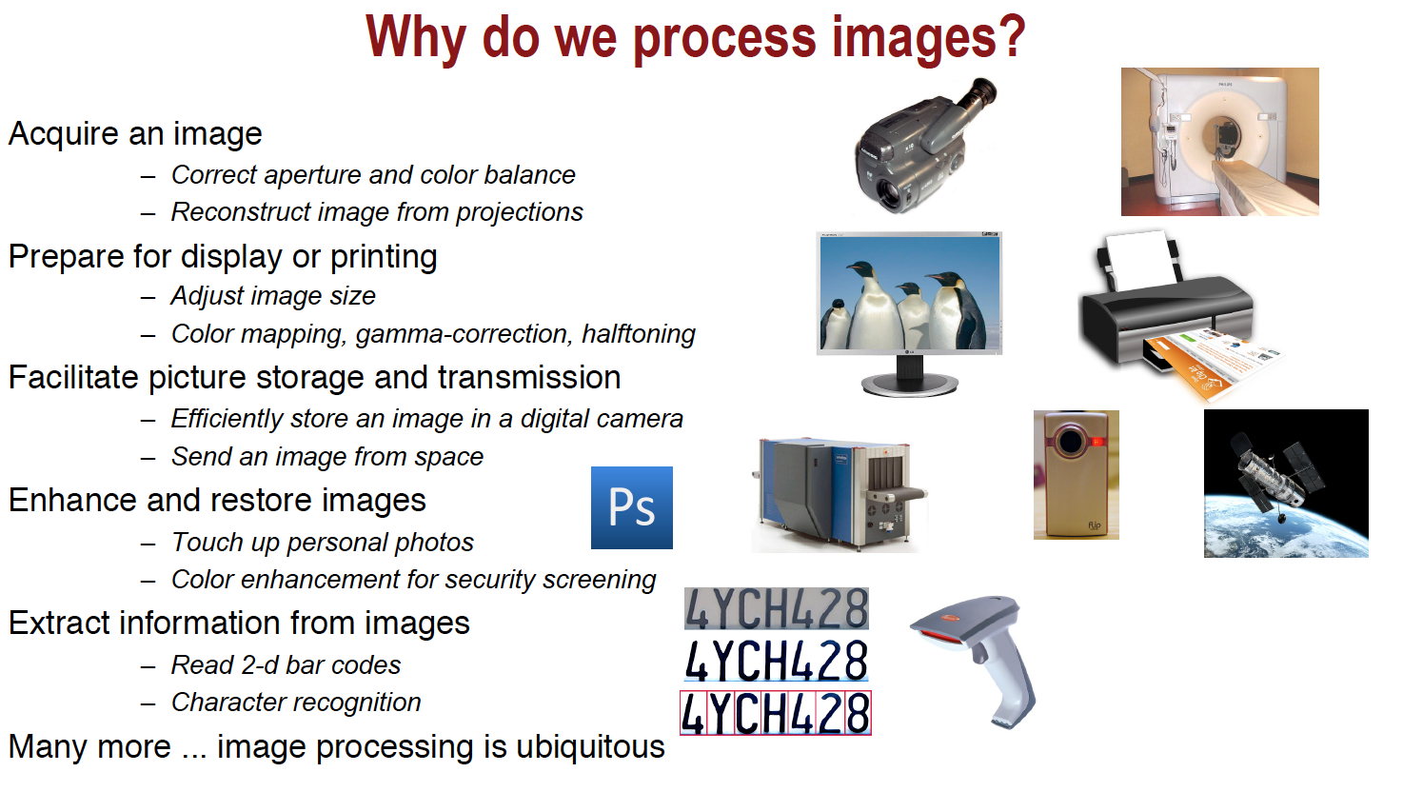
Applications of CV(Computer Vision)

Slide 24
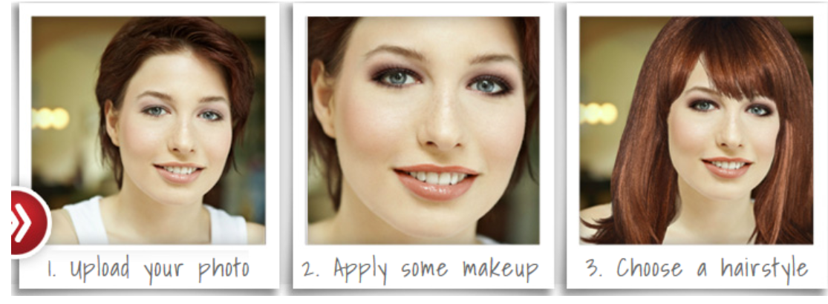
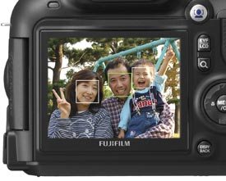
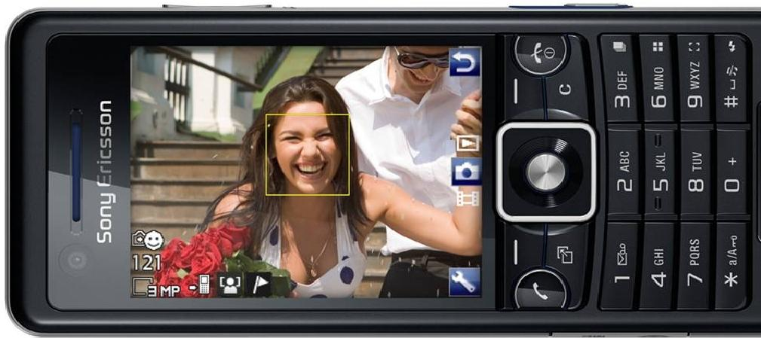
Face Detection & Virtual Makeover
Applications of CV

Slide 25

Applications of CV
Transportation Safety
Pedestrian Detection and
Behavior Analysis

Slide 26
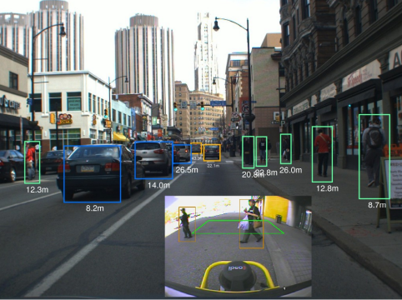
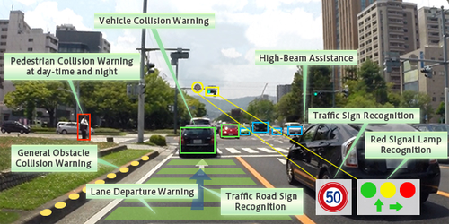
Advanced Driver Assistance System (ADAS)
Applications of CV

Slide 27
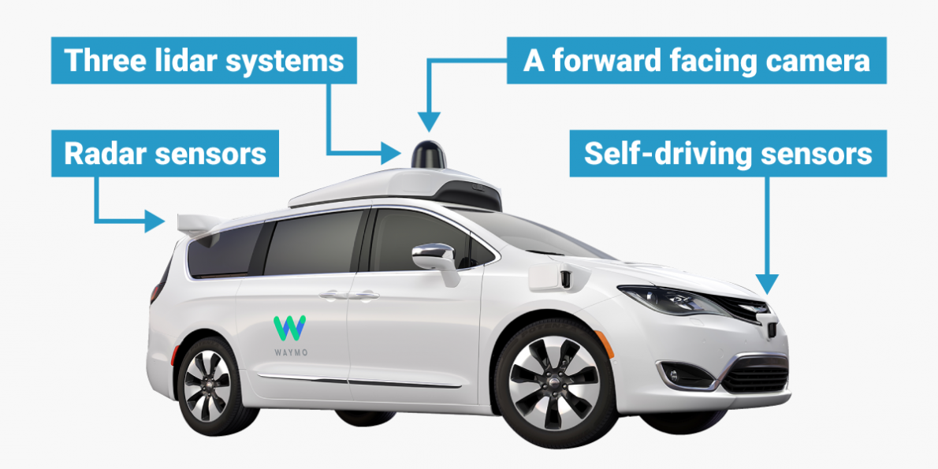
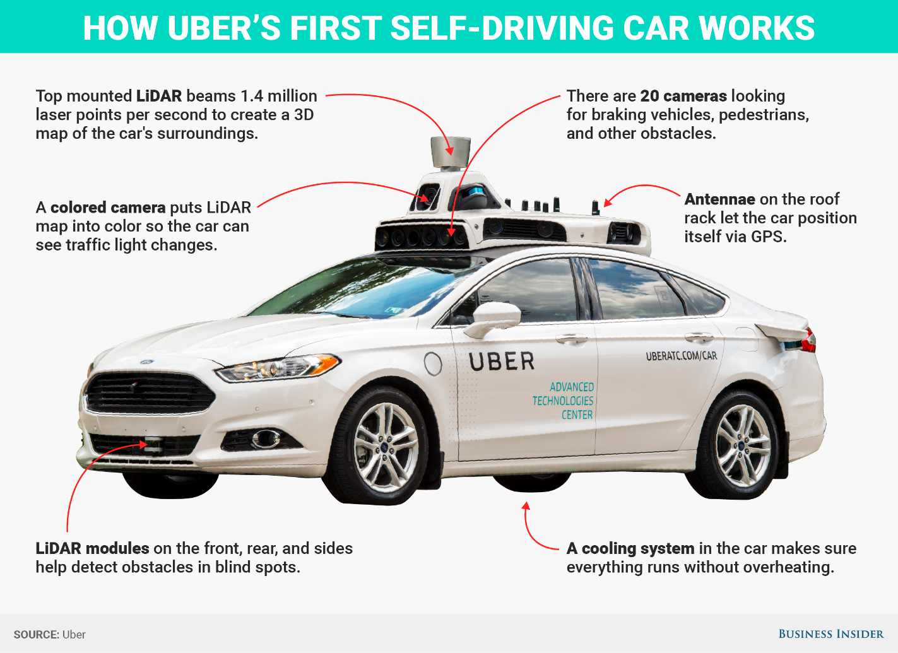
Self-Driving Car
Applications of CV

Slide 28
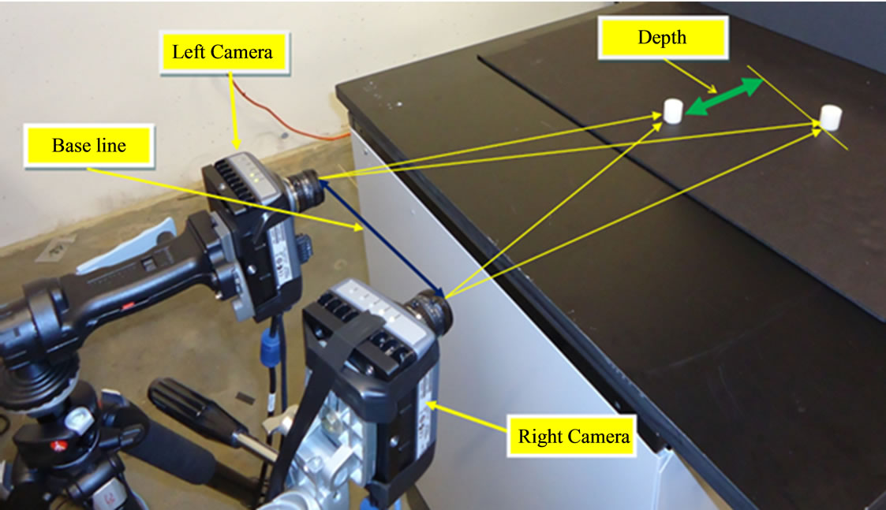
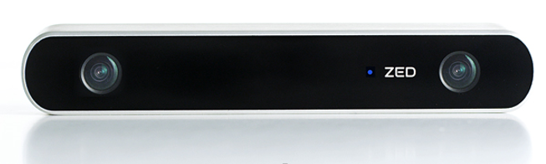
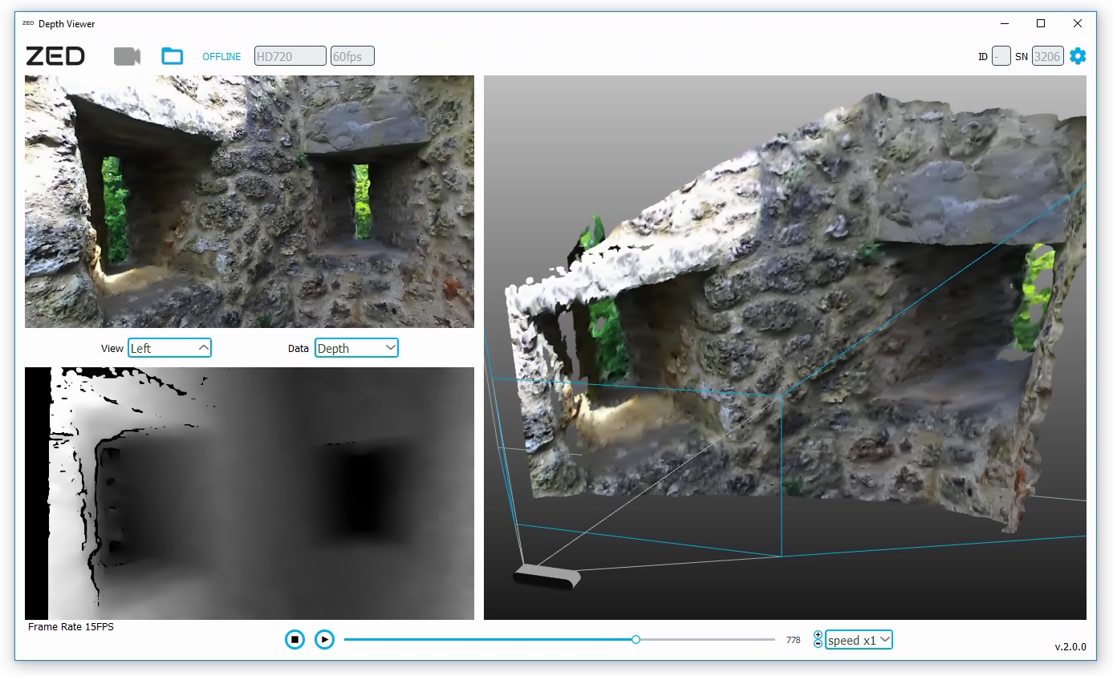
Stereo Imaging
Applications of CV

Slide 29
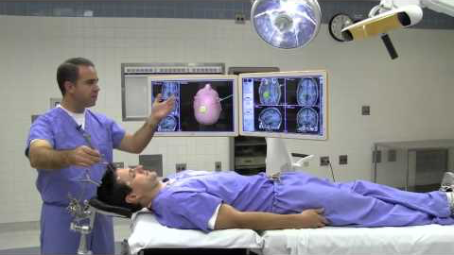
Image Guided Surgery
Applications of CV

Slide 30
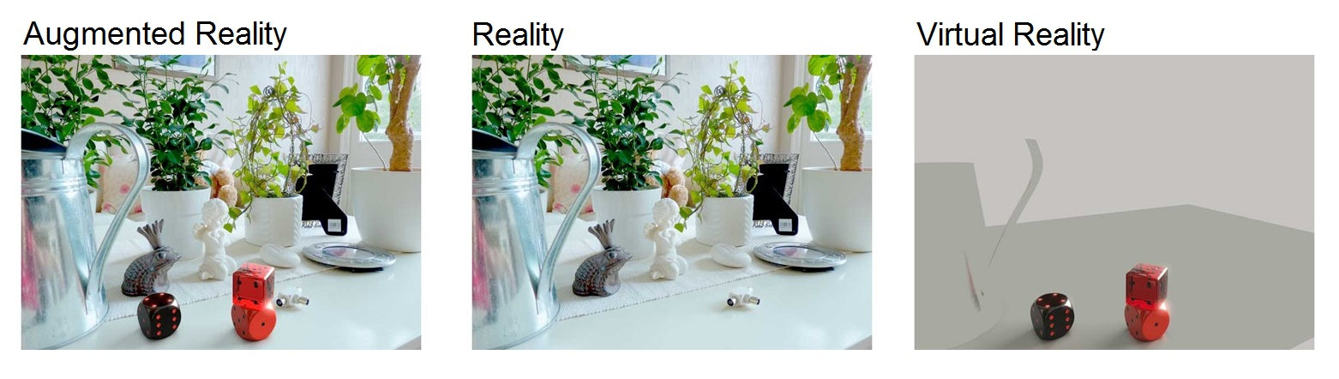
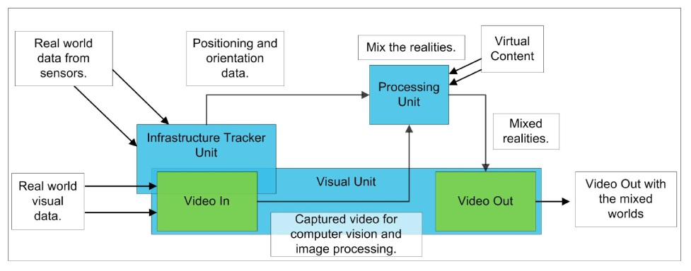
Applications of CV

Slide 31
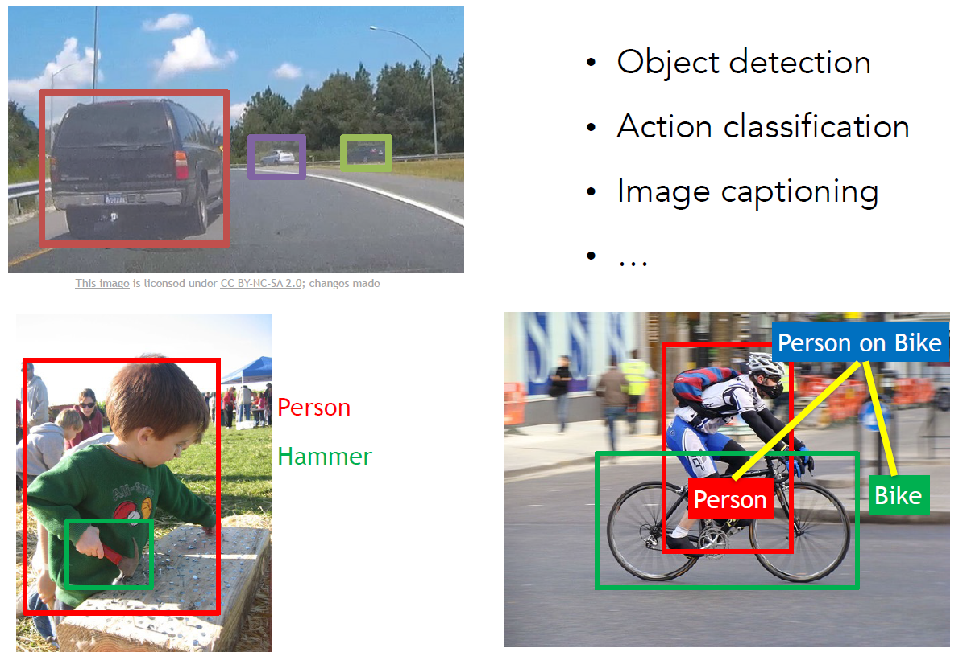
Applications of CV

Slide 32
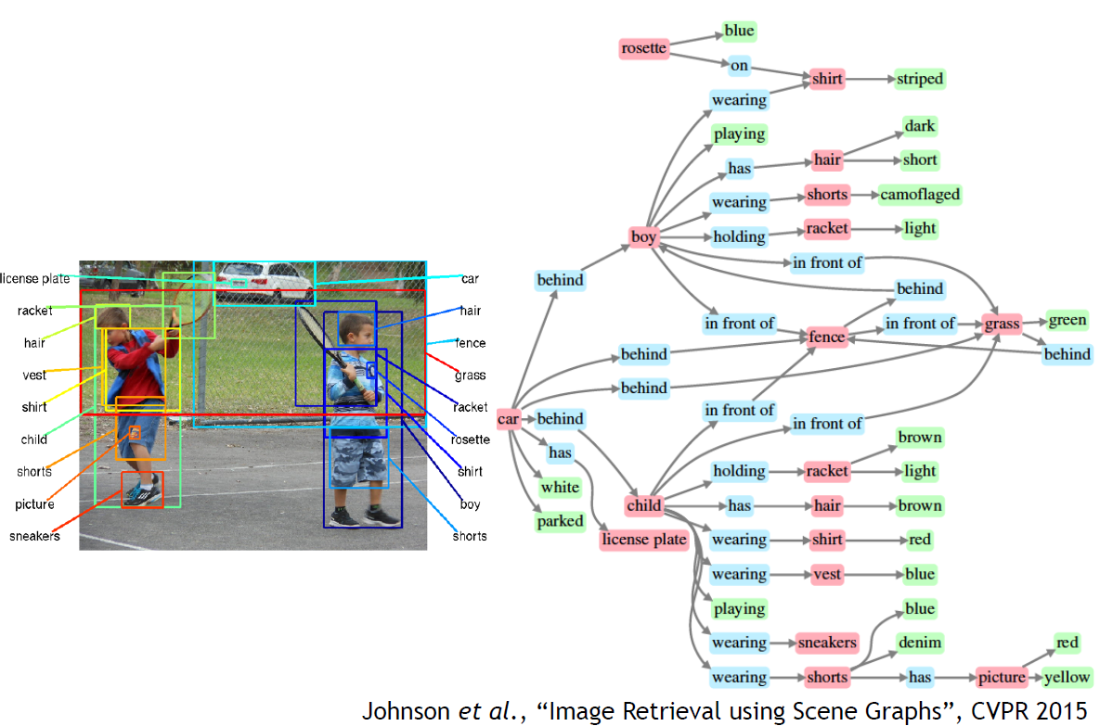
Applications of CV
Deep Learning

